Slide 1

HEPATITIS CLASSIFICATION PROJECT
PRESENTED by:
T GANESH

Slide 2
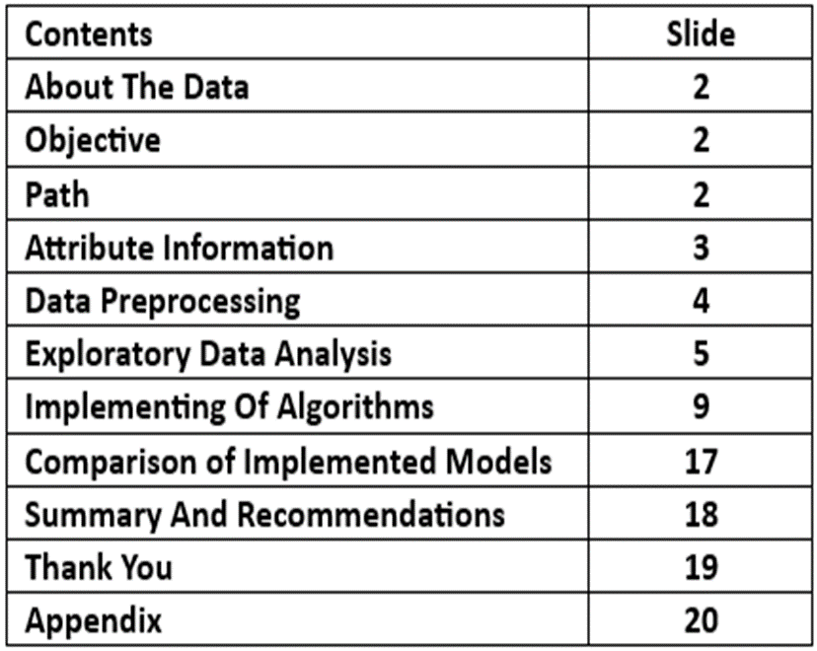
INDEX

Slide 3
ABOUT THE DATA:
The dataset appears to contain information related to hepatitis, comprising various attributes such as age, sex, medical history, and laboratory test results. (e.g., bilirubin levels, SGOT, albumin, etc.) OBJECTIVE :
The objective of this dataset is likely to develop a classification model to predict whether a patient is likely ,To survive (LIVE) or die (DIE) based on these attributes, aiding in the prognosis and treatment planning for hepatitis patients
PATH :
Implementing multiple machine learning algorithms to fit the best model for the dataset

Slide 4
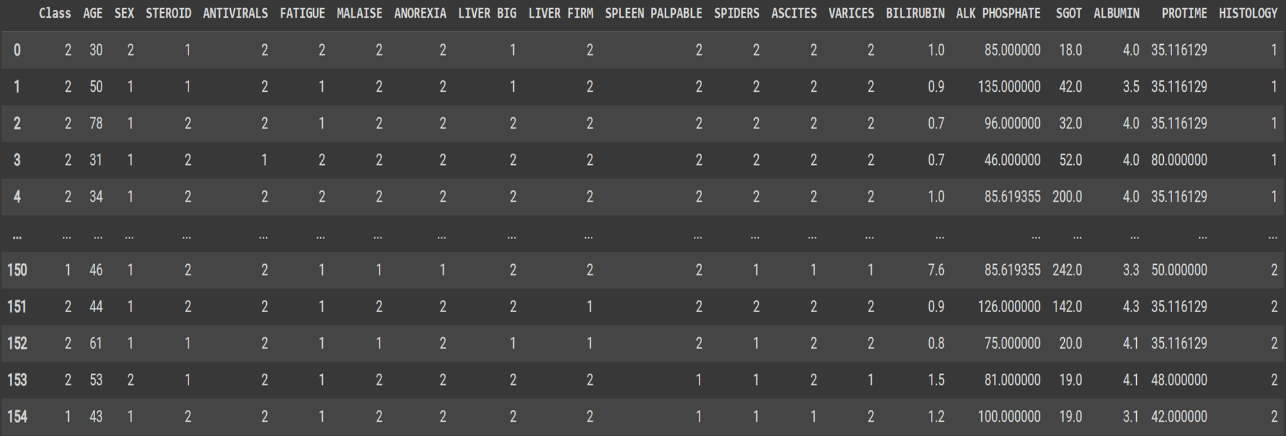
DATASET

Slide 5
DATA CLEANING
Data Cleaning:
The structure of the data set is in the correct format .The data set doesn’t contain duplicate values .
Handling with missing values :
There are null values in the dataset . The columns that contain null values are
BILIRUBIN, ALK PHOSPHATE , SGOT , ALBUMIN , PROTIME , In these columns we replace the null values with zero then we replace the zero with mean of the respective column.
STEROIDS , ANTIVIRALS , FATIGUE , ANOREXIA , LIVERBIG, SPLEEN PALPABLE , SPIDERS , ASCITES , VARICES. In these columns we replace the null values with zero then we replace the zero with mode of the respective column.

Slide 6
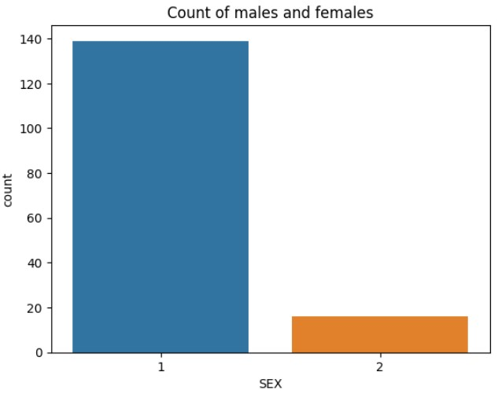
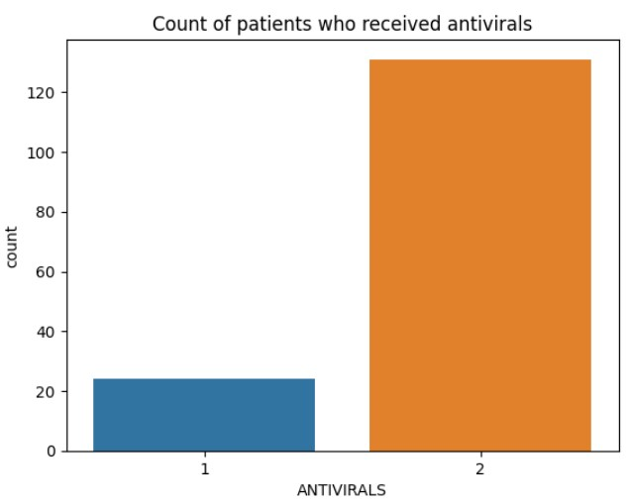
EDA

Slide 7
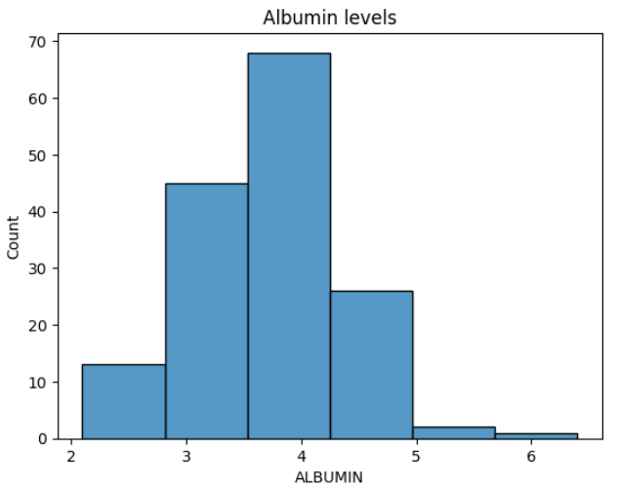
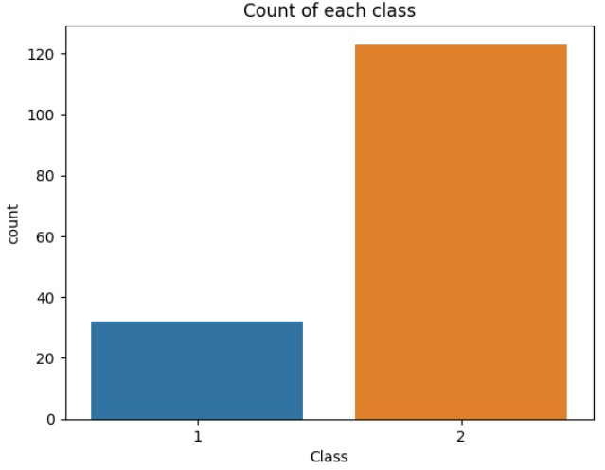

Slide 8
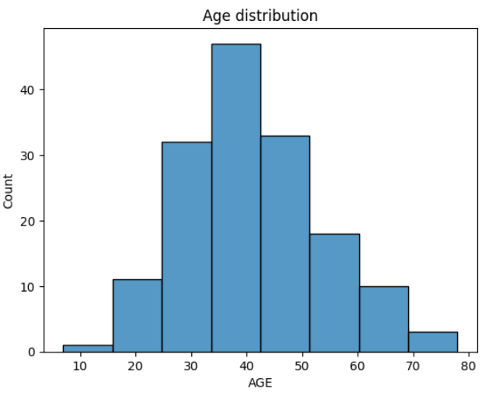
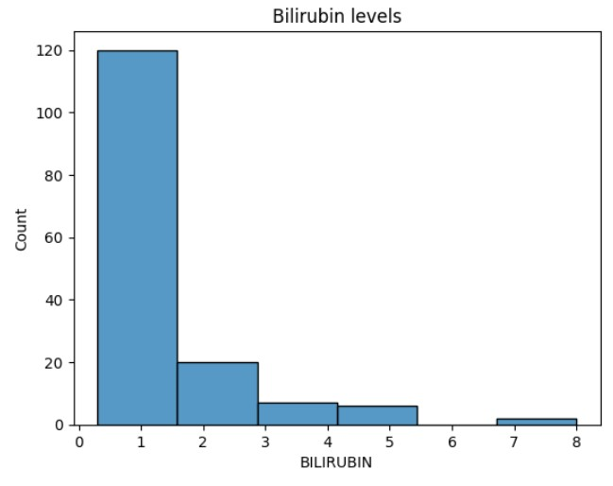

Slide 9
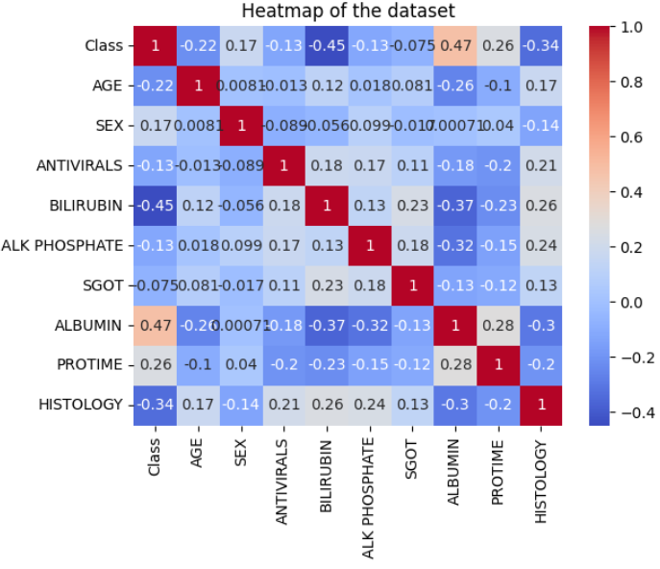

Slide 10
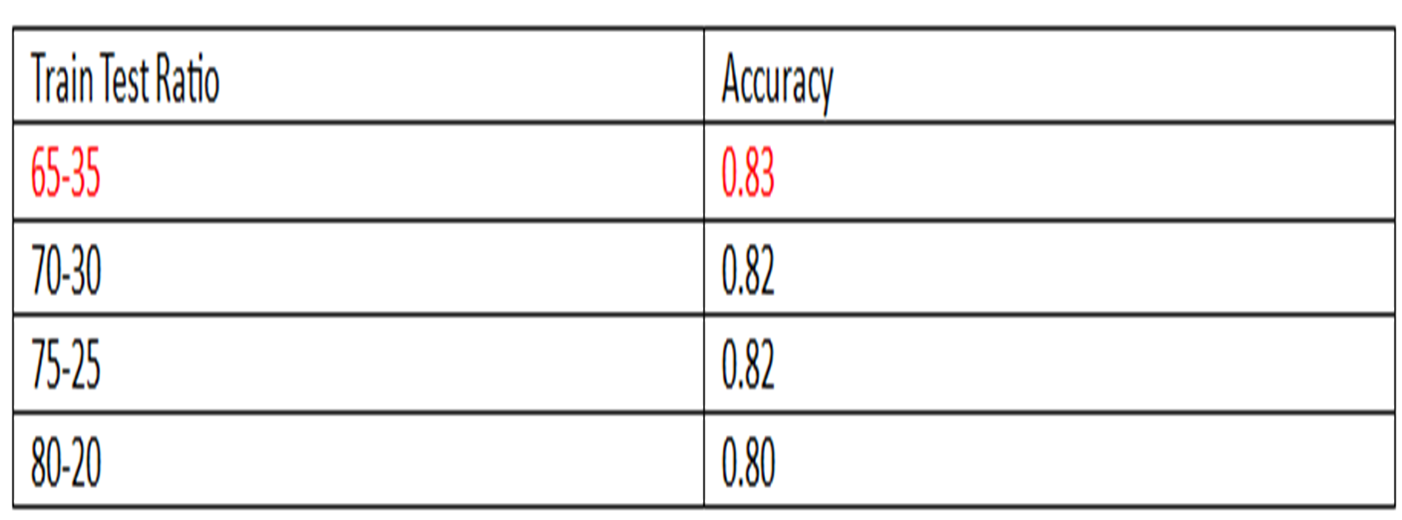
Logistic regression

Slide 11
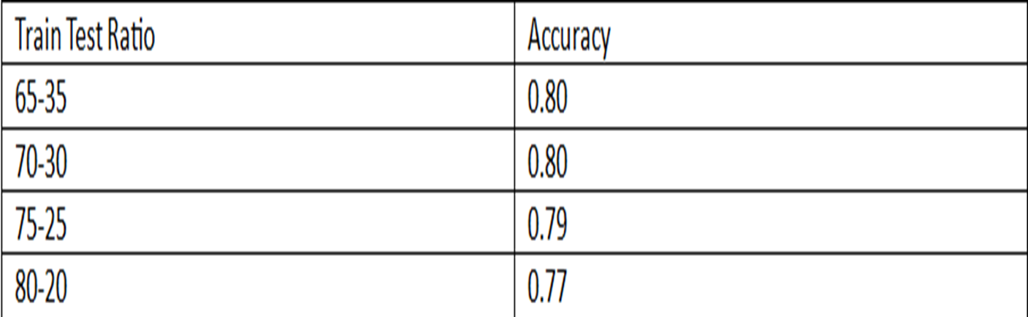
Support vector machine

Slide 12
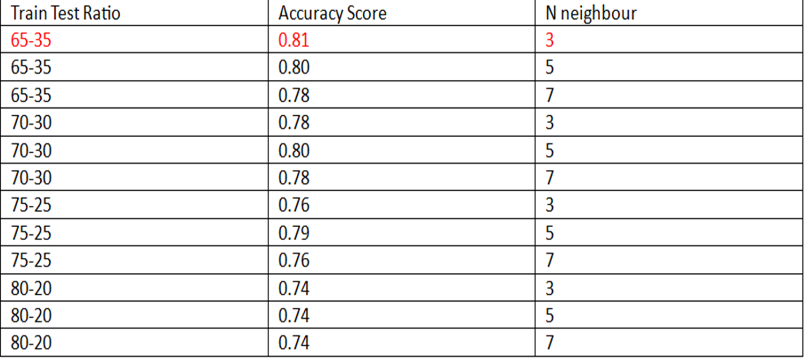
K-nearest neighbors

Slide 13
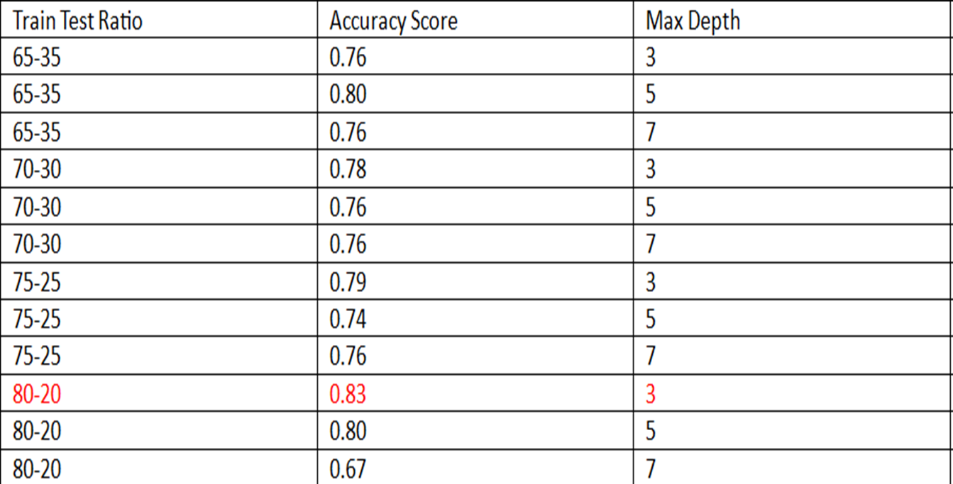
Decision tree

Slide 14
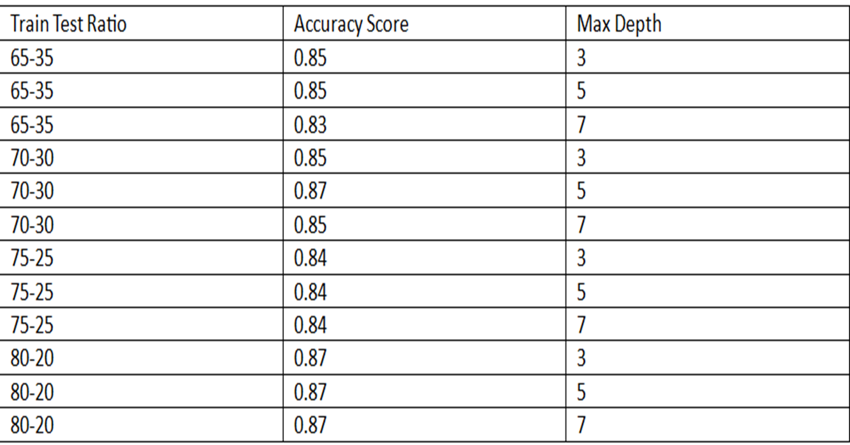
Random forest

Slide 15
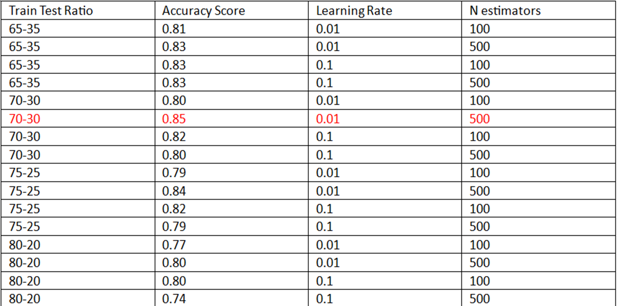
Ada boost

Slide 16
Gradient boosting

Slide 17
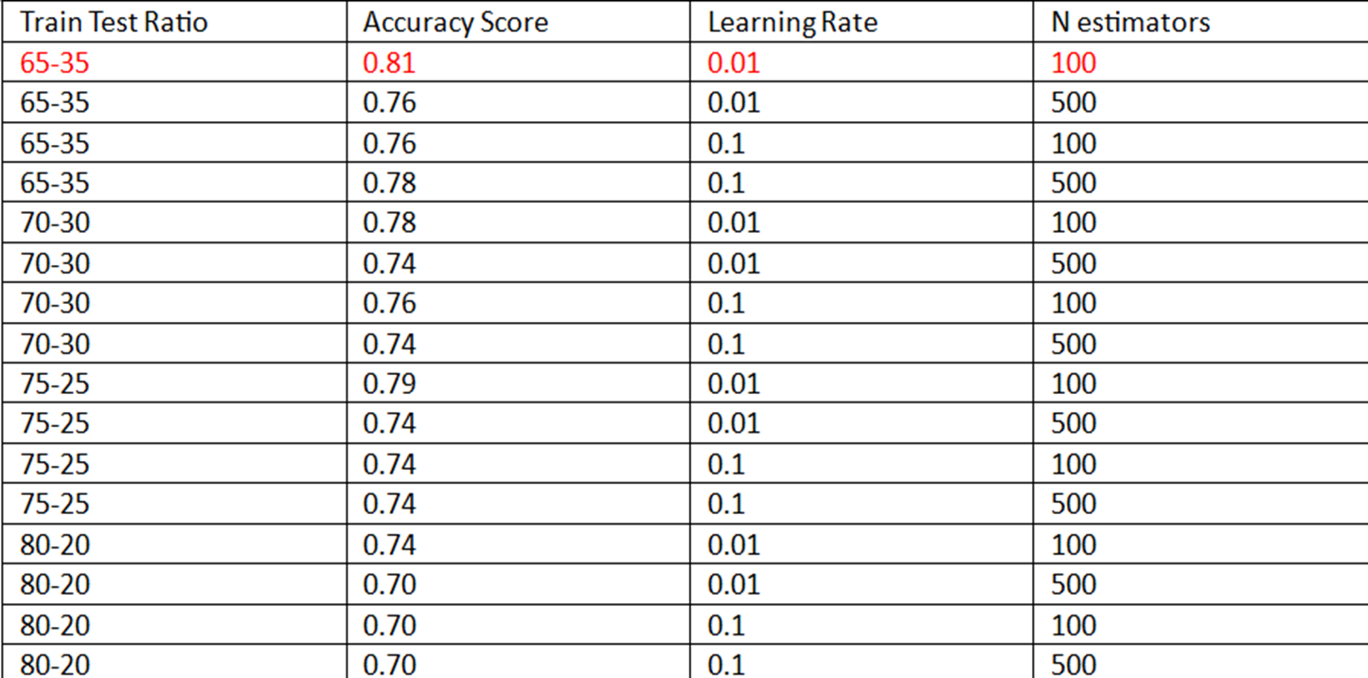
Xg boost

Slide 18
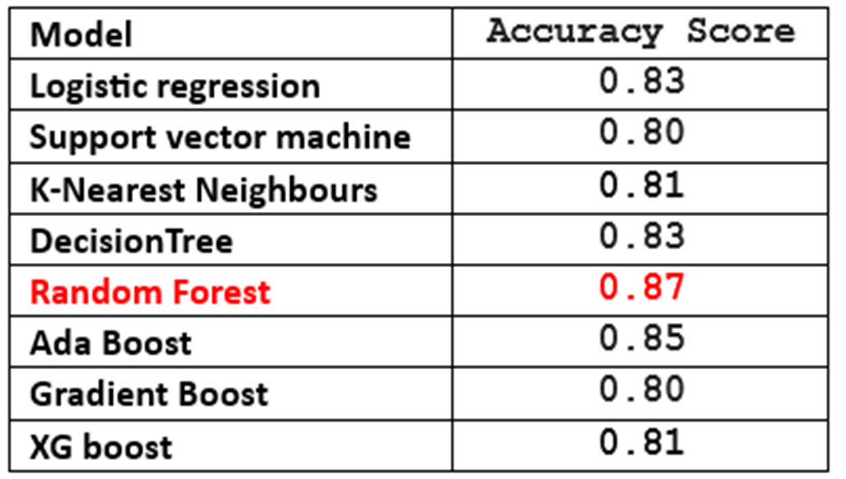
COMPARISION OF IMPLEMENTED MODELS

Slide 19
Summary And Recommendations
For the Hepatitis Dataset , we performed five types of machine learning algorithms: Logistic Regression, SVM , KNN, Bagging and Boosting.
From all the analysis and implementations of the algorithm, we found the best results in Random Forest i.e. for 80-20 train-test ratio( parameters : Max depth=7) with Accuracy Score of 0.87 (87%).
So, here we can conclude that the above Algorithms can be considered as the best models for the given Hepatitis dataset.

Slide 20
THANK YOU!!

Slide 21
Appendix

Slide 22
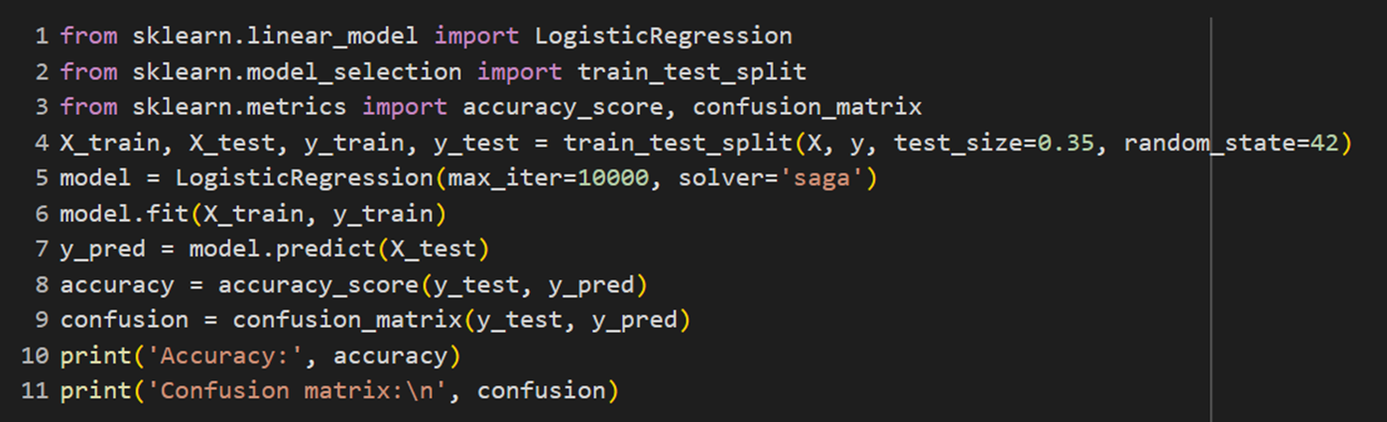
Logistic Regression

Slide 23
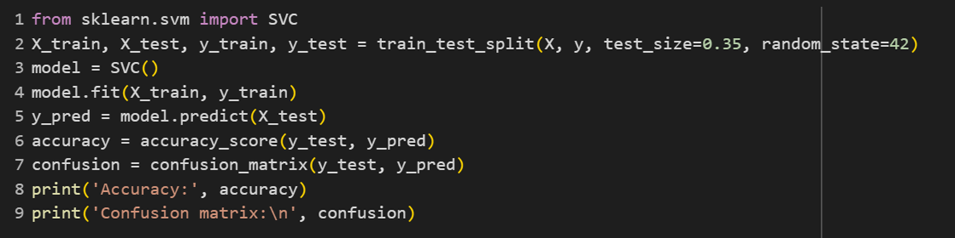
Support vector machine

Slide 24
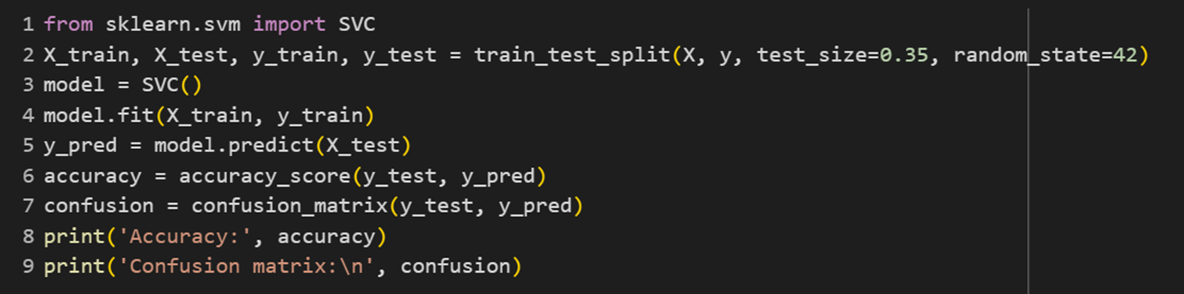
K-Nearest Neighbours

Slide 25
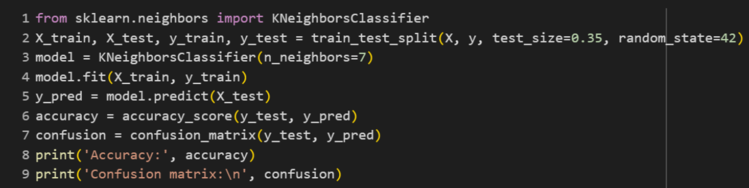
Decision Tree

Slide 26
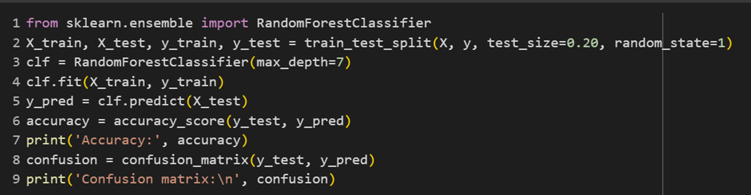
Random forest

Slide 27
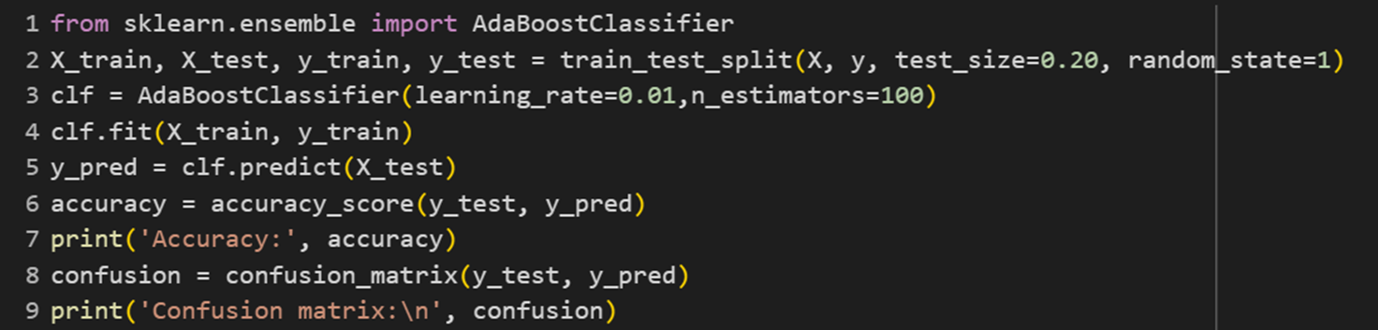
Ada Boost

Slide 28
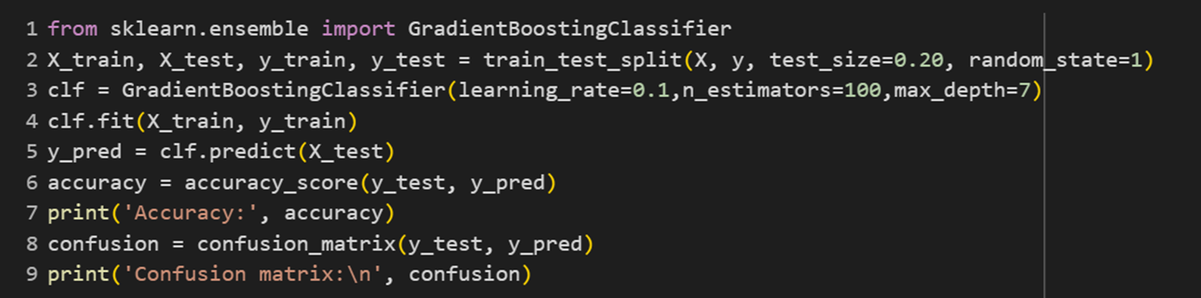
Gradient Boosting

Slide 29
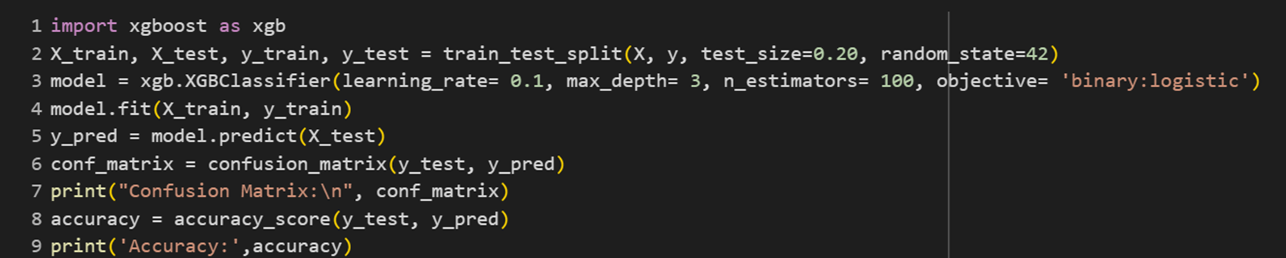
XG Boost

